Slide 1
Digital Business Models

Slide 2
The proliferation and convergence of digital technologies like SMACIT (social, mobile, analytics, cloud, and Internet of Things) has created significant threats and opportunities to established companies. Business leaders must rethink their business strategies and develop what we refer to as a digital strategy. Our research shows four keys to successfully defining and executing a digital strategy:
Zeroing in on a customer engagement or digitized solutions strategy to guide the transformation,
Building operational excellence,
Creating a powerful digital services backbone to facilitate
rapid innovation and responsiveness,
(4) Ensuring ongoing organizational redesign.

Slide 3
To help companies seize the opportunities and mitigate the threats of new technologies, MIT CISR and The Boston Consulting Group (BCG) embarked on a study we called Designing Digital Organizations. We explored two questions. First, what strategies best address the opportunities and challenges presented by digital disruption? Second, what must companies do to successfully execute those strategies?

Slide 4
For purposes of this study, we defined digital disruption as changes in the competitive environment resulting from the use of digital technologies by new market entrants or established competitors in ways that undermine the value proposition of a company’s product/service portfolio or go-to-market approach.

Slide 5
We have found that competitive advantage results from the increased integration that digital technologies enable. This integration can take a variety of forms, such as
unique, value-adding connections between the company’s products and services;
meaningful integration of internal business capabilities;
(3) seamless interactions with customers and partners; and perhaps even
(4) extraordinary coordination of discrete events.
Such uses of technology to enhance a company’s strategic competencies are difficult to accomplish and thus difficult to replicate. As a result, integration constitutes the basis for competition in the digital economy.

Slide 6
We define digital strategy as a business strategy inspired by the capabilities of powerful, readily accessible technologies (like SMACIT) intent on delivering unique, integrated business capabilities in ways that are responsive to constantly changing market conditions.

Slide 7
Our research revealed four keys to successfully defining and implementing a digital strategy:
1. An effective digital strategy zeroes in on one of two opportunities that are associated with digital disruption— customer engagement or digitized solutions.
2. Operational excellence is essential for digital strategy execution and sustained success. Successful companies will rely on capabilities that have been built into a powerful operational backbone.
3. Rapid innovation and responsiveness to new market opportunities are equally essential. To facilitate this kind of agility, successful companies will rely on the capabilities of a powerful digital services backbone.
4. Existing organizational designs are not well suited to building and leveraging both an operational and a digital services backbone. Ongoing organizational redesign that includes structures, processes, roles, partnerships, and skills is essential to execute a digital strategy.

Slide 8
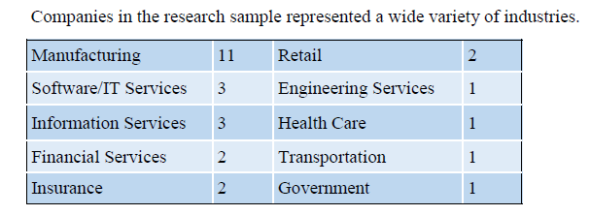

Slide 9
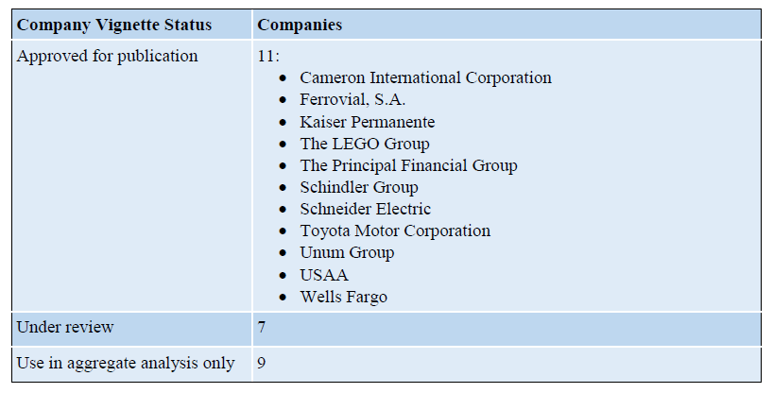

Slide 10
Two Types of Digital Strategies
Companies attack digital disruption with two types of digital strategies: customer engagement and digitized solutions. As already noted, these strategies are business (not technology) strategies inspired by the capabilities of powerful, readily accessible technologies such as SMACIT, intent on delivering unique, integrated business capabilities in ways that are responsive to constantly changing market conditions.

Slide 11
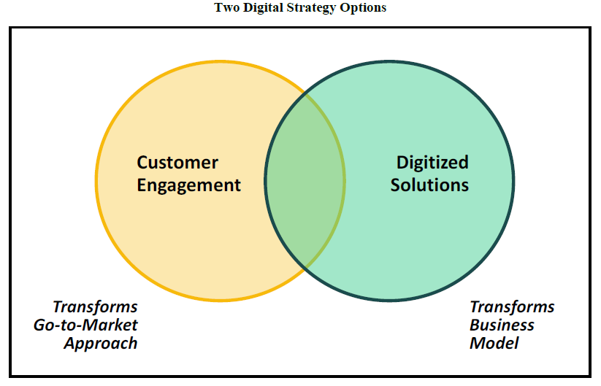

Slide 12
Examples of customer engagement strategies include:
Nordstrom’s commitment to a personalized, seamless experience across both full-price and off-price merchandise, and both in-store and online shopping options
USAA’s focus on helping members to navigate important "life events" (e.g., getting married, having a baby, buying a house, retiring)
The LEGO Group’s commitment to fostering a global community in its efforts to inspire and develop the builders of tomorrow through creative play and learning
Kaiser Permanente’s dedication to providing a patient–provider collaboration that leads to better health for its members

Slide 13
Examples of digitized solutions strategies include:
GE’s emphasis on delivering asset performance management services for big assets such as wind turbines, aircraft engines, and medical equipment3
John Deere’s commitment to developing smart, connected products and ecosystems that guide farmers to smarter, more efficient ways to grow plants
Ferrovial’s use of digital technologies to develop and operate infrastructure solutions such as toll roads with rates that vary according to demand
Schindler’s strategy to become a provider of urban mobility solutions, first focusing on more efficient movement of people within buildings and eventually facilitating more efficient movement of people within cities
Royal Philips’ “strategy to enable an ecosystem for new types of connected and personalized digital health solutions”

Slide 14
It Is Essential to Choose a Digital Strategy
In our research sample, twenty-three of twenty-seven companies defined a digital strategy that we could easily categorize as either customer engagement or digitized solutions. The other four companies had not yet articulated a digital strategy.

Slide 15
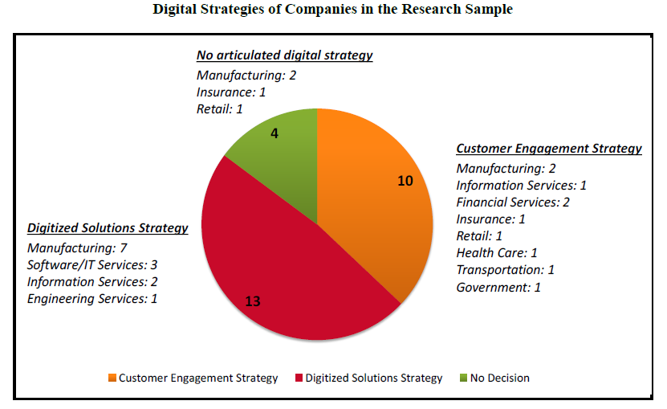

Slide 16
Ultimately, digitization will likely impact every company’s product/service portfolio and its go-to-market approach. However, our research suggests that companies need to decide which of the two approaches will drive their business transformation. As far as we can tell, no company has been successful in pursuing the two strategies at the same time. We expect that is because as a company pursues two strategies, it will not be able to fully integrate them. The choice of one strategy determines the priority, thus declaring a winner in debates on business priorities before the fight begins.

Slide 17
An Operational Backbone Is Table Stakes for a Digital Strategy
Companies have been building operational backbones since the late 1990s, when the emergence of ERPs and CRMs exposed the benefits of replacing siloed systems and processes with more standardized and integrated systems and processes. We define operational backbone as the set of systems and processes that ensure the efficiency, scalability, reliability, quality, and predictability of a company’s core operations. As companies grow, an operational backbone becomes essential for efficient, scalable, reliable, and predictable business processes.
The requirements for the backbone vary according to company strategy, but the most common appear to be:
Consistent source of truth for critical data (e.g., customer data, order data, product data)
Seamless transaction processing with end-to-end visibility
Standardized, widely adopted back-office shared services

Slide 18
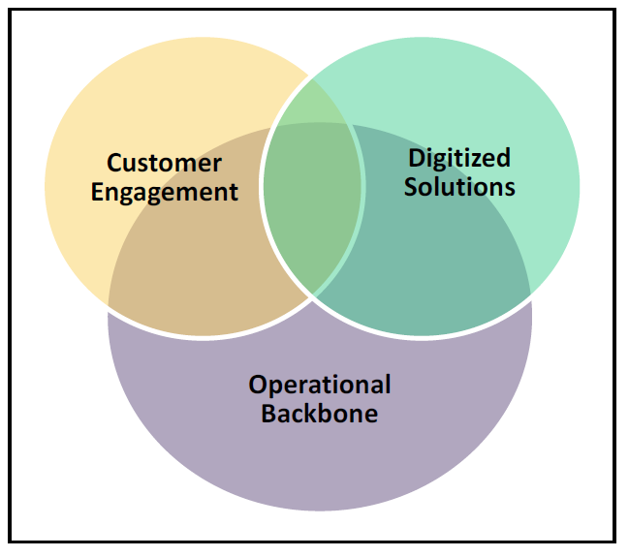

Slide 19
For example:
A key element of Nordstrom’s operational backbone is the transparency of its supply chain. This transparency allows both employees and customers to see and easily acquire any item the company has available at any warehouse or store. It also facilitates easy returns across all channels.
At the heart of USAA’s operational backbone is a customer file that ensures that member-facing USAA employees have full information on each member’s accounts, transactions, and interactions. The data is available equally for online and mobile transactions. This customer knowledge is important for supporting an individual’s “life events.”
Ferrovial built an operational backbone of shared back-office services. These shared services create synergies across the company’s individual businesses.
Schindler’s operational backbone started with an ERP implementation that provided technology and value chain optimization across formerly independent subsidiaries.
Kaiser Permanente’s operational backbone is built around the electronic health record (EHR). Leaders note that the EHR is essential for both accurate recordkeeping and for collaboration among physicians and between healthcare providers, patients, and their families.

Slide 20
A Digital Services Backbone Enables Rapid Innovation
Companies that have a strong operational backbone recognize its enormous opportunities—and limitations. A growing number of companies are identifying the need for a second backbone that addresses a very different set of capabilities. We refer to this new backbone as a digital services backbone. We define a digital services backbone as the set of technology and business capabilities that serve as a base for rapid development and implementation of digital innovations.

Slide 21
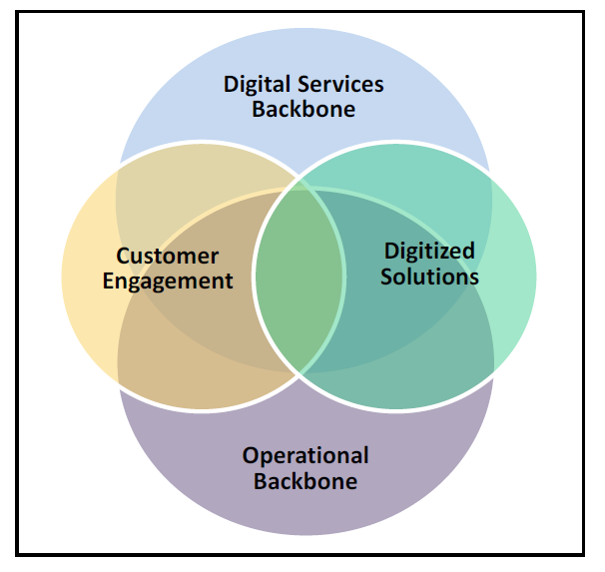

Slide 22
Companies that are building digital services backbones tend to rely on cloud services companies to provide underlying platforms, usually referred to as Platform as a Service (PaaS). Like the operational backbone, a digital services backbone may rely on many platforms. But a digital services backbone appears to require less time and money to establish and sustain.
In fact, the digital services backbone acts more like a coral reef. A minimal platform can support an incrementally growing set of business components—and a natural rejuvenation as some components die off. Thus, the digital services backbone has lesser demands for maintenance than an operational backbone.

Slide 23
We describe the design challenge of the digital economy as one in which companies are attempting to simultaneously build both a solid, integrated operational backbone and a rapidly expanding, loosely coupled set of services on a digital services backbone while deploying the capabilities of both backbones to implement a digital strategy that is clearly articulated but constantly evolving.

Slide 24
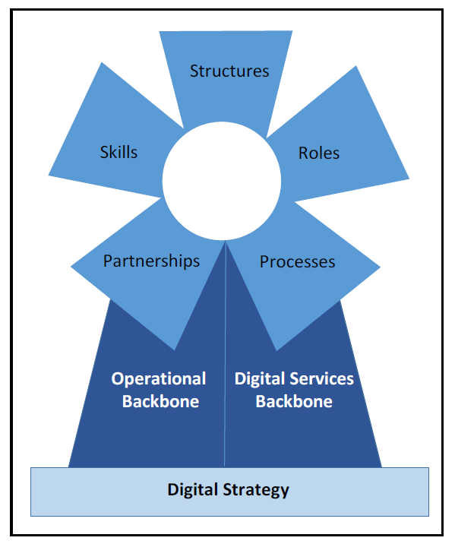

Slide 25
Structures: As companies become more digital, they often design new structures to address new
responsibilities. Most notably, these new organizational units take on responsibility for digital innovation,
speed, and agility. They can take various forms.
Ferrovial created an innovation center of twenty-five people reporting to the Chief Information and Innovation Officer. This team is serving all of Ferrovial’s businesses to generate an innovative atmosphere and to find new solutions to customer needs and pursue those solutions as innovation projects.
Schindler created Schindler Digital Business AG, which houses both teams that build and maintain digital services and that focus on the operational backbone. The digital services teams have been specifically charged with thinking about innovative ideas all the time.
Kaiser Permanente created an IT unit charged with adding services for its Generation 2 platform. Kaiser Permanente transformed its IT organization by adopting a service-centric operating model. IT now designs standard assemblies for IT services that are chosen by its business users.

Slide 26
Continued:
John Deere has a team of over eight hundred employees responsible for digital innovation that includes software developers, systems engineers, product testers, marketers, and customer support personnel. Known as the Intelligent Solutions Group (ISG), this team has historically focused on technologies embedded in John Deere equipment.
GE created its Software Center of Excellence, funded by a $1 billion investment in 2011 and located in GE Global Research, to make the transition to a software/analytics company. A key initiative was the development of the Predix platform.
In September 2015, Philips opened its first HealthSuite Labs co-creation center, where multidisciplinary teams that include healthcare providers, patients, and Philips clinical, design, digital, and business experts rapidly develop innovative solutions on the HealthSuite Digital Platform to address specific healthcare challenges.

Slide 27
Roles: To ensure that these new structures actually work across verticals—and don’t just create another divide and conquer approach to getting work done—companies are introducing horizontal roles. For example, at most companies, process leaders and data owners and their teams continue to
facilitate the integration made possible by the operational backbone. Meanwhile, new units responsible for building digital services usually create integrator roles. These integrators build connections to the activities of the new units with other parts of the company.
For example, the head of Philips HealthSuite Labs plays primarily an integrator role, drawing on resources from across Philips Healthcare businesses. Similarly, Ferrovial’s two innovation managers are responsible for problem identification and problem solving across business units.

Slide 28
Processes: As companies build and integrate their operational and digital services backbones, they are designing processes that encourage collaboration and learning about how to succeed digitally. These processes are designed to address two concerns:
the need for rapid innovation to address customer expectations and competitor moves, and
the need for coordination both among organizational units responsible for innovation and between innovation activities and the efforts to maintain and enhance the operational backbone.

Slide 29
The need for rapid innovation has led to new development methodologies and practices:
Principal Financial and GE are among many companies that have implemented agile methodologies to bring new services quickly to the market.
Kaiser Permanente introduced a DevOps model with the goal to further reduce cycle times significantly.
Several companies emphasize the importance of the minimum viable product (MVP) in their rapid, collaborative development. Schindler, for example, has adopted the MVP technique in its work with service technicians for rapid introduction of new digital services.

Slide 30
Companies building digital services backbones are moving toward systematic, proactive approaches to synchronizing innovations across the company with the discipline required to maintain and enhance the operational backbone.
Kaiser Permanente’s executive committee and four technology councils establish priorities for new enterprise services. Its IT services management model supports mid-level innovation efforts by enabling clinical and operational departments to choose, receive, and discard services depending on their needs and budget.
The LEGO Group instituted enterprise architecture challenge sessions in which representatives from across the business areas explored the architectural impacts of major projects.
With growing demand for innovation from digital delivery to digital products, USAA is considering creative ways to ensure alignment, such as by sending automated notifications of what different groups are developing.

Slide 31
Partnerships: Schneider Electric, Ferrovial, and others rely on vendor partners to implement
and host key elements of their operational backbones in the public cloud. Those partnerships have accelerated the companies’ progress toward executing digital strategies. More recently, companies have
started relying on partners to develop services in order to expand their digital services backbones.
Toyota North America’s Consumer Portal Delivery (CPD) group, which coordinates Toyota’s digital innovation with established processes, has found that startups make valued partners when developing digital components.
John Deere has connected to Climate Corporation's Climate FieldView platform, which enables farmers using certain John Deere equipment to collect and directly share data and to use data visualization and customized, data science-driven insights to manage farming activities from the tractor cab.
Like Apple, Royal Philips and GE are opening their digital services platforms to partners that can build upon them to offer services to customers—for example, to deliver healthcare services built onto Philips’ platform, or asset performance management services developed on GE’s.

Slide 32
Skills: Newly established organizational units charged with building digital services backbones
often recruited a wide variety of digital talent and created innovative physical workspaces.
Schindler Digital Business recruited industrial designers and even game developers to compliment traditional IT talent in multidisciplinary teams.
GE recruited a leader to build its new software center of excellence who could manage a startup in a large, complex company. He scaled up his team to one thousand employees within two years. To facilitate interfacing with the other environments in the organization, companies introduced talent development initiatives.
Ferrovial's corporate university created new digital seminars.
The LEGO Group introduced a digital boot camp and hackathons. The company designed open workspaces to encourage new ways of working.
Toyota North America’s IT unit has implemented a variety of processes in order to encourage innovation. The company holds innovation fairs and seeds funding of innovative ideas through an Innovation Council. Such initiatives are intended to increase innovative thinking across the enterprise, leading to an enhanced customer experience both before and after the sale.

Slide 33
Recommendations: How to Design a Digital Organization
A digital transformation is a long journey. Based on our findings, we have six recommendations for
companies trying to map a successful journey.
Define a digital strategy focused on either customer engagement or digitized solutions.
Identify where you most need better integration or standardization at this time and make the next investment in your operational backbone there.
Develop a digital services backbone by identifying—and working with technology partners to build—the infrastructure you need to protect, connect, analyze, and support innovative services.
Once you’ve designed robust infrastructure capabilities, enlist partners to help populate your digital services backbone.
Design the interface between the two backbone environments and evangelize the importance of architecture throughout the organization.
Recognize that the skills and cultures that support the digital services backbone environment will differ markedly from the skills and cultures that companies need to support their operational backbone environment. Think creatively about how to foster both cultures.

